Slide 1
Python (III)
- Comprehension
Unpacking and Packing
Function
Input and Output
楊延齡 博士
hayato655169@gmail.com
07/14/2020

Slide 2

Comprehension
124
>>> range(10000000)
# => [0, 1, 2, 3, 4, 5, 6, 7, 8, 9, …]
[0, 1, 4, 9, 16, 25, 36, 49, 64, 81, …]
>>> squares = []
>>> for x in range(10000000):
... squares.append(x**2)
Notes:
https://docs.python.org/3/tutorial/datastructures.html#nested-list-comprehensions

Slide 3
List Comprehension
125
new_list = [expression for_loop_one]
>>> a = [x**2 for x in range(3)]
# => [0, 1, 4]
range(3)
0
1
2
List comprehensions provide
a concise way to create lists
x²
x²
x²
4
[0, ]
1,
Notes:
https://docs.python.org/3/tutorial/datastructures.html#nested-list-comprehensions

Slide 4
Conditionals in List Comprehension
126
>>> a = []
>>> for x in range(3) :
>>> if x < 2:
... a.append(x)
range(3)
0
1
2
>>> a = [x for x in range(3) if x < 2]
if x < 2
if x < 2
if x < 2
True
True
False
# => [0, 1]
x
x
1
[0, ]
Notes:
https://docs.python.org/3/tutorial/datastructures.html#nested-list-comprehensions
https://data-flair.training/blogs/python-list-comprehension/

Slide 5
Nested Conditionals
127
>>> a = []
>>> for x in range(7) :
>>> if x % 2:
>>> if x % 3:
... a.append(x)
>>> a = [x for x in range(7) if x%2 == 0 if x%3 == 0]
# => [0, 6]
Notes:
https://data-flair.training/blogs/python-list-comprehension/

Slide 6
if-else in List Comprehension
128
>>> ["NTHU" if x%2 == 0 else "CHE" for x in range(2)]
# => ['NTHU', 'CHE']
>>> [ x+1 if x >= 5 else x**2 for x in range(10) ]
# => [0, 1, 4, 9, 16, 6, 7, 8, 9, 10]
Notes:
https://data-flair.training/blogs/python-list-comprehension/

Slide 7
Nested List Comprehension
129
>>> a = []
>>> for x in [1,2,3]:
>>> for y in [3,1,4]:
>>> if x != y:
... a.append( (x, y) )
>>> [(x, y) for x in [1,2,3] for y in [3,1,4] if x != y]
# => [(1, 3), (1, 4), (2, 3), (2, 1), (2, 4), (3, 1), (3, 4)]
Tuple must be parenthesized, otherwise an error is raised
Notes:
https://docs.python.org/3/tutorial/datastructures.html#nested-list-comprehensions

Slide 8
Dict in List Comprehension
130
>>> a = [x for x in {'a': 1, 'b': 2, 'c': 3, 'd': 4, 'e': 5}.keys()]
# => ['a', 'b', 'c', 'd', 'e']
>>> a = [x for x in {'a': 1, 'b': 2, 'c': 3, 'd': 4, 'e': 5}.values()]
# => [1, 4, 9, 16, 25]
>>> a = [x for x in {'a': 1, 'b': 2, 'c': 3, 'd': 4, 'e': 5}.items()]
# => [('a', 1), ('b', 4), ('c', 9), ('d', 16), ('e', 25)]

Slide 9
Dict Comprehension
131
>>> a = {'a': 1, 'b': 2, 'c': 3}
>>> b = {keys : values**2 for (keys, values) in a.items()}
# => {'a': 1, 'b': 4, 'c': 9}
Notes:
https://www.datacamp.com/community/tutorials/python-dictionary-comprehension?utm_source=adwords_ppc&utm_campaignid=10267161064&utm_adgroupid=102842301792&utm_device=c&utm_keyword=&utm_matchtype=b&utm_network=g&utm_adpostion=&utm_creative=278443377095&utm_targetid=dsa-473406574715&utm_loc_interest_ms=&utm_loc_physical_ms=9073389&gclid=EAIaIQobChMItuv105-26gIVEnZgCh2iIAt6EAAYASAAEgLlQPD_BwE

Slide 10
Practice
132
>>> vec = [-4, -2, 0, 2, 4]
>>> [x*2 for x in vec] # => [-8, -4, 0, 4, 8]
>>> [x for x in vec if x >= 0] # => [0, 2, 4]
>>> [abs(x) for x in vec] # => [4, 2, 0, 2, 4]
>>> freshfruit = [' banana', ' loganberry ', 'passion fruit ‘]
>>> [weapon.strip() for weapon in freshfruit] # => ['banana', 'loganberry', 'passion fruit’]
>>> [(x, x**2) for x in range(6)] # => [(0, 0), (1, 1), (2, 4), (3, 9), (4, 16), (5, 25)]
>>> vec = [[1,2,3], [4,5,6], [7,8,9]]
>>> [num for elem in vec for num in elem] # => [1, 2, 3, 4, 5, 6, 7, 8, 9]

Slide 11
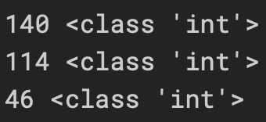
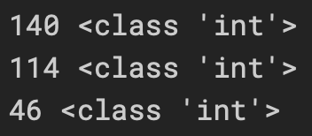
Iterator Unpacking
133
Unpacking List
Unpacking Tuple
>>> IP = [140, 114, 46]
>>> TANet, NTHU, CHE = IP
>>> print(TANet, type(TANet))
>>> print(NTHU, type(NTHU))
>>> print(CHE,type(CHE))
>>> IP = 140, 114, 46
>>> TANet, NTHU, CHE = IP
>>> print(TANet, type(TANet))
>>> print(NTHU, type(NTHU))
>>> print(CHE, type(CHE))
Notes:
https://www.datacamp.com/community/tutorials/usage-asterisks-python#PIF
https://note.nkmk.me/en/python-tuple-list-unpack/
https://stackabuse.com/unpacking-in-python-beyond-parallel-assignment/

Slide 12
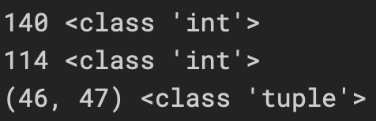
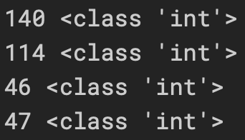
Unpacking Nested Tuple (List)
134
>>> IP = (140, 114, (46, 47))
>>> TANet, NTHU, CHE = IP
>>> print(TANet, type(TANet))
>>> print(NTHU, type(NTHU))
>>> print(CHE, type(CHE))
>>> IP = (140, 114, (46, 47))
>>> TANet, NTHU, (CHE1, CHE2) = IP
>>> print(TANet, type(TANet))
>>> print(NTHU, type(NTHU))
>>> print(CHE1, type(CHE1))
>>> print(CHE2, type(CHE2))
Notes:
https://www.datacamp.com/community/tutorials/usage-asterisks-python#PIF
https://note.nkmk.me/en/python-tuple-list-unpack/
https://stackabuse.com/unpacking-in-python-beyond-parallel-assignment/

Slide 13
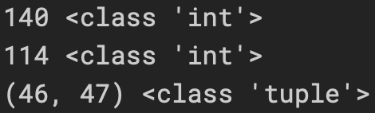
Dropping Unneeded Values with _
135
>>> IP = (140, 114, (46, 47))
>>> TANet, NTHU, _ = IP
>>> print(TANet, type(TANet))
>>> print(NTHU, type(NTHU))
>>> print( _, type( _ ))
Notes:
https://www.datacamp.com/community/tutorials/usage-asterisks-python#PIF
https://note.nkmk.me/en/python-tuple-list-unpack/
https://stackabuse.com/unpacking-in-python-beyond-parallel-assignment/

Slide 14
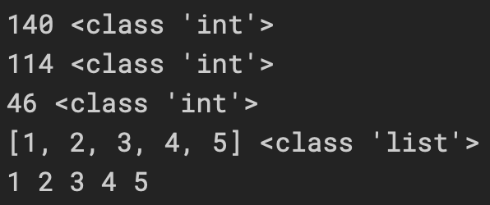
Unpacking Tuple (List) with *
136
>>> IP = (140, 114, 46, 1, 2, 3, 4, 5)
>>> TANet, NTHU, CHE, *Lab = IP
>>> print(TANet, type(TANet))
>>> print(NTHU, type(NTHU))
>>> print(CHE, type(CHE))
>>> print(Lab, type(Lab))
>>> print(*Lab) #iterator cannot use type
Notes:
https://www.datacamp.com/community/tutorials/usage-asterisks-python#PIF
https://note.nkmk.me/en/python-tuple-list-unpack/
https://stackabuse.com/unpacking-in-python-beyond-parallel-assignment/

Slide 15
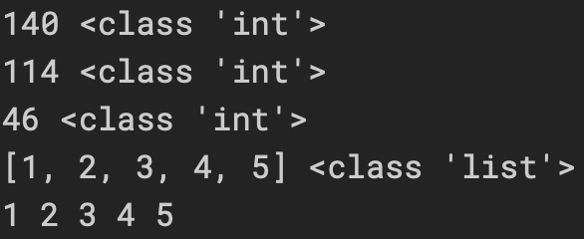
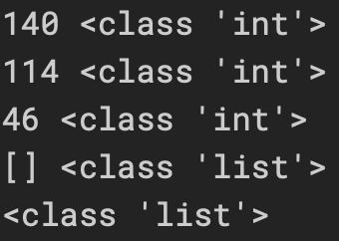
Unpacking Tuple (List) with *_
137
>>> IP = (140, 114, 46, 1, 2, 3, 4, 5)
>>> TANet, NTHU, CHE, *_ = IP
>>> print(TANet, type(TANet))
>>> print(NTHU, type(NTHU))
>>> print(CHE, type(CHE))
>>> print( _, type( _ ))
>>> print(*_) #iterator cannot use type
>>> IP = (140, 114, 46)
>>> TANet, NTHU, CHE, *_ = IP
>>> print(TANet, type(TANet))
>>> print(NTHU, type(NTHU))
>>> print(CHE, type(CHE))
>>> print( _, type( _ ))
>>> print(*_, type( _ ))
Notes:
https://www.datacamp.com/community/tutorials/usage-asterisks-python#PIF
https://note.nkmk.me/en/python-tuple-list-unpack/
https://stackabuse.com/unpacking-in-python-beyond-parallel-assignment/

Slide 16
Merging Iterables with *
138
>>> insert = [i for i in range(1,10)]
>>> merge = (0, *insert, 10)
>>> print(merge)
Notes:
https://www.datacamp.com/community/tutorials/usage-asterisks-python#PIF
https://note.nkmk.me/en/python-tuple-list-unpack/
https://stackabuse.com/unpacking-in-python-beyond-parallel-assignment/

Slide 17
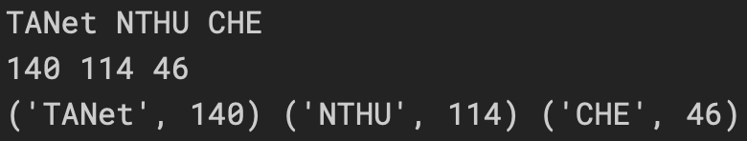
Unpacking Dictionaries in Python
139
>>> IP = {"TANet":140, "NTHU":114, "CHE":46}
>>> a,b,c = IP
>>> print(a,b,c)
>>> a,b,c = IP.values()
>>> print(a,b,c)
>>> a,b,c = IP.items()
>>> print(a,b,c)
Notes:
https://www.datacamp.com/community/tutorials/usage-asterisks-python#PIF
https://note.nkmk.me/en/python-tuple-list-unpack/
https://stackabuse.com/unpacking-in-python-beyond-parallel-assignment/

Slide 18
Packing Dictionaries with **
140
>>> IP = {"TANet":140, "NTHU":114, "CHE":46}
>>> print({**IP})
Notes:
https://www.datacamp.com/community/tutorials/usage-asterisks-python#PIF
https://note.nkmk.me/en/python-tuple-list-unpack/
https://stackabuse.com/unpacking-in-python-beyond-parallel-assignment/

Slide 19
Merging Dict with **
141
>>> IP = {"TANet":140, "NTHU":114}
>>> print(dict( {**IP}, CHE1=46, CHE2=47 ))
Notes:
https://www.datacamp.com/community/tutorials/usage-asterisks-python#PIF
https://note.nkmk.me/en/python-tuple-list-unpack/
https://stackabuse.com/unpacking-in-python-beyond-parallel-assignment/

Slide 20
Merging Dict with **
142
# In dictionaries, later values will always override earlier ones >>> print({ 'x': 1, **{'x': 2} })
>>> print({ **{'x': 2}, 'x':1 })
# => {'x': 2}
# => {'x': 1}
https://www.python.org/dev/peps/pep-0448/
Notes:
https://www.python.org/dev/peps/pep-0448/

Slide 21
Function
143
>>> rho = 997 #kg/m^3
>>> velocity = 1.00 #m/s
>>> diameter = 0.08 #80mm
>>> viscosity = 0.98 #cP
>>> Renold_number = rho * velocity * diameter / viscosity
>>> Renold_number(rho, velocity, diameter, viscosity)

Slide 22
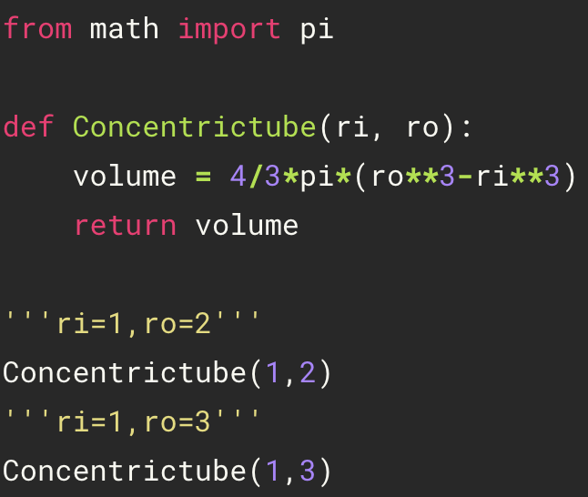
Defining Functions
144
space
def name( parameters ):
statements
return [expression]
name( arguments )
definition
Indent
call function
Parameter: Defined by the names that appear in a function definition
Argument: The values actually passed to a function when calling it
The arguments in calling function
match that in defining function!!
Notes:
https://www.tutorialspoint.com/python/python_functions.htm
https://docs.python.org/3/faq/programming.html#what-is-the-difference-between-arguments-and-parameters

Slide 23
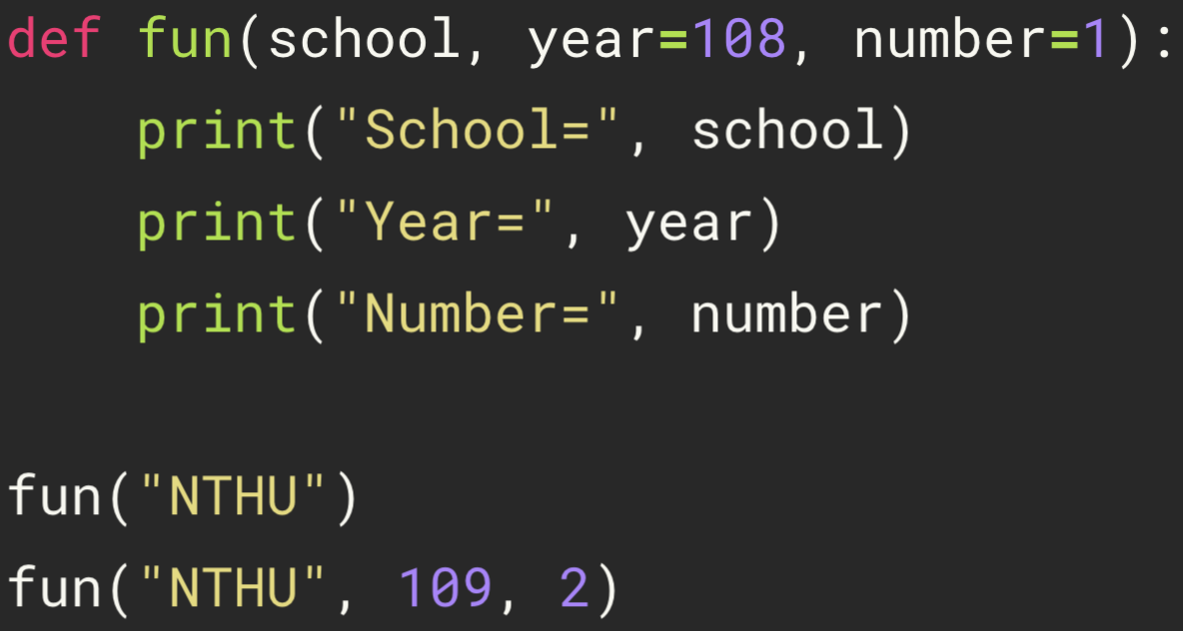
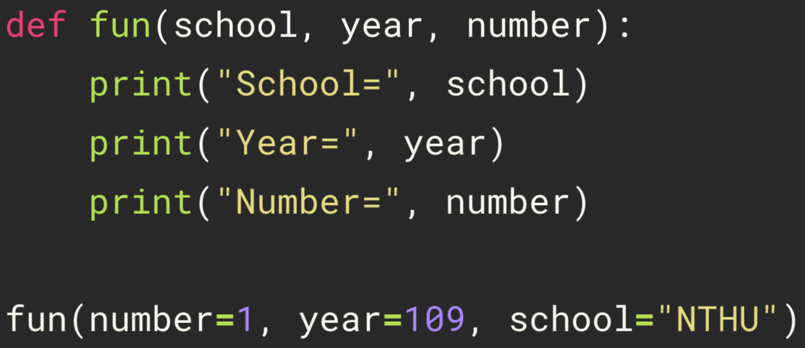
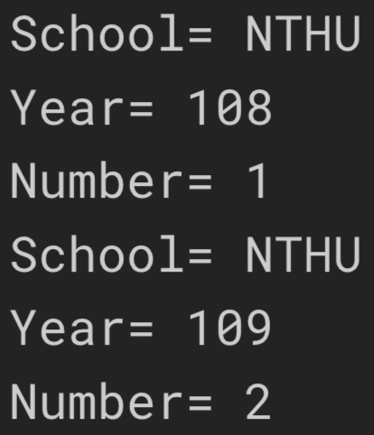
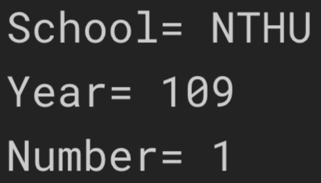
Argument
145
Default arguments
Keyword arguments
The order of the arguments does not matter
Notes:
https://www.tutorialspoint.com/python/python_functions.htm

Slide 24
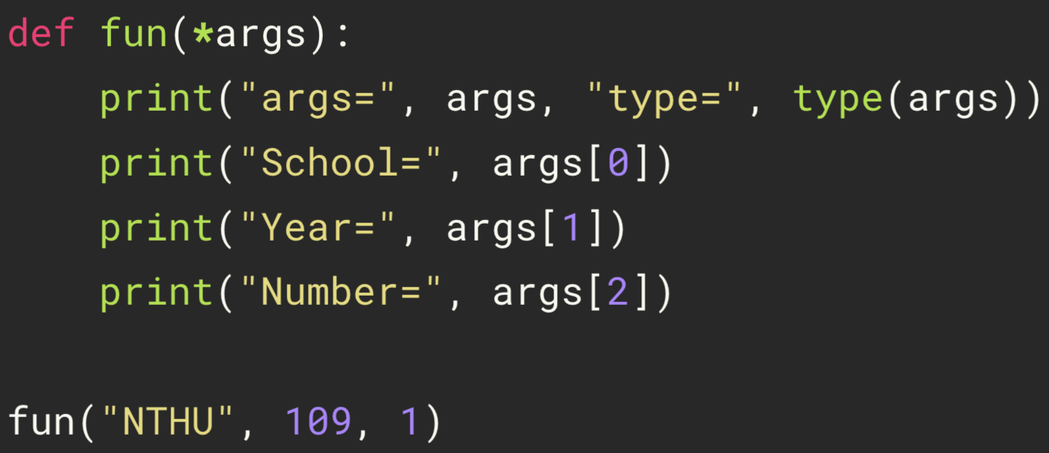
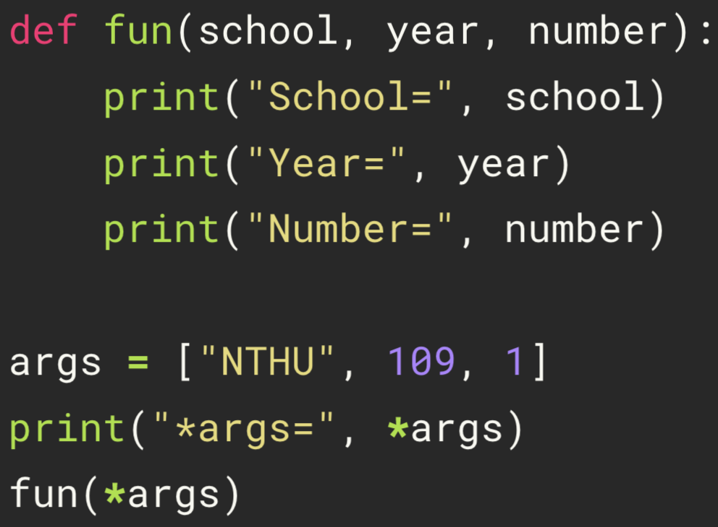
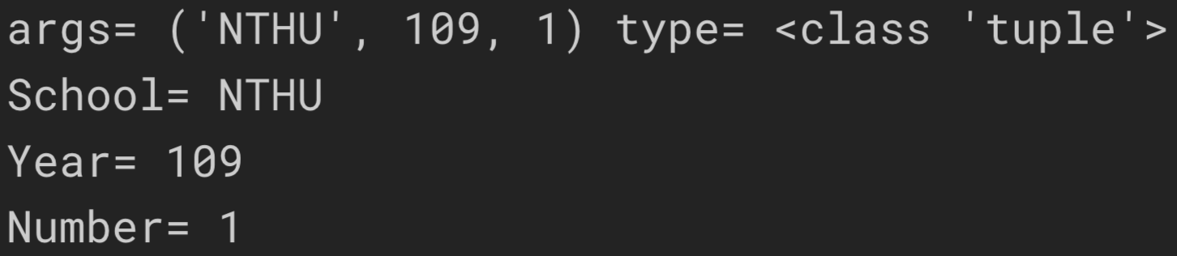
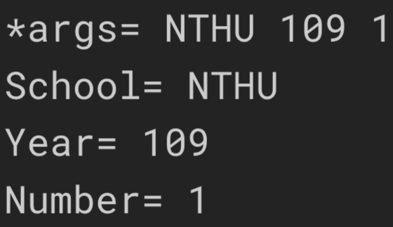
Packing or Unpacking into Arguments
146
Packing arguments
Unpacking arguments
Notes:
http://kodango.com/variable-arguments-in-python

Slide 25
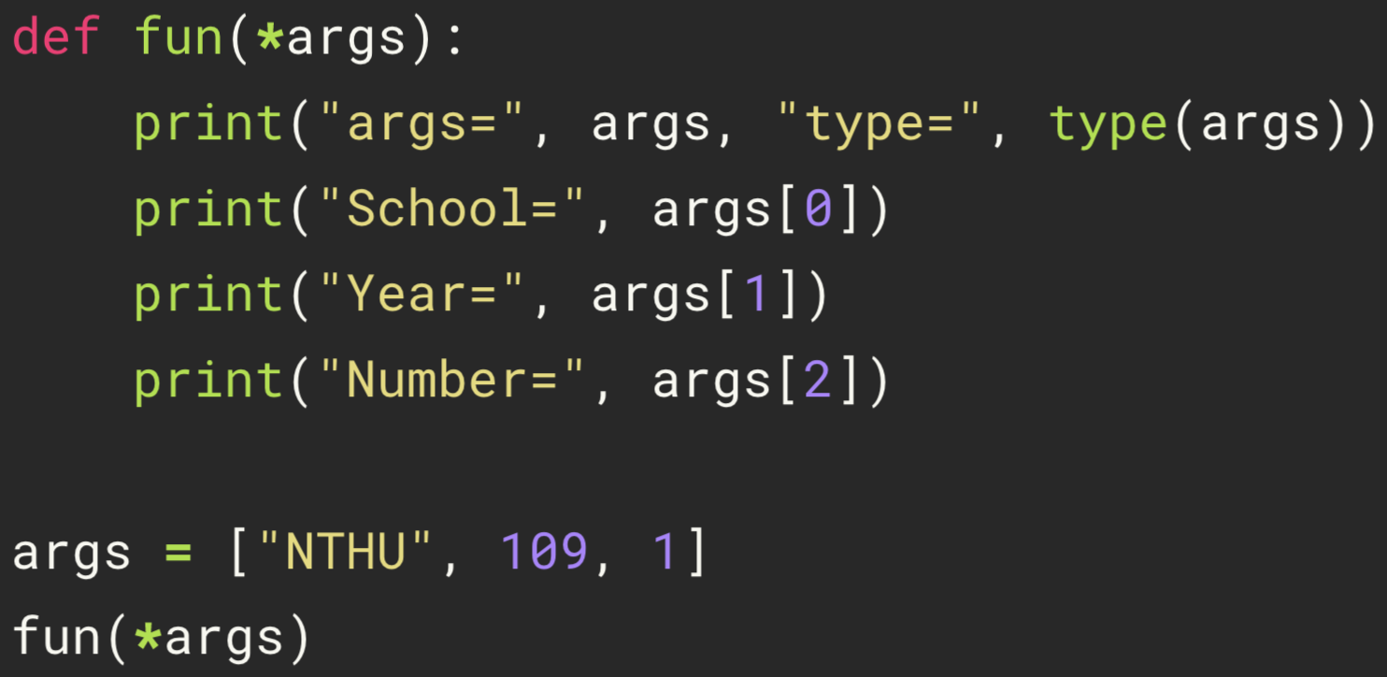
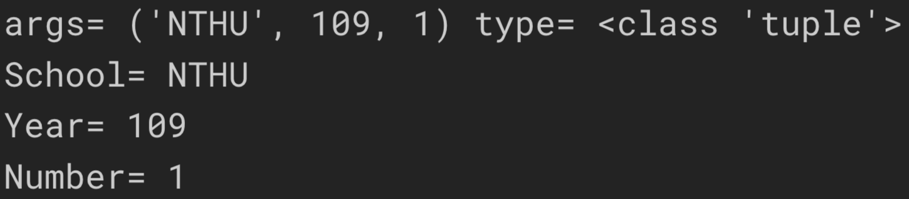
Packing and Unpacking into Arguments
147
Notes:
http://kodango.com/variable-arguments-in-python

Slide 26
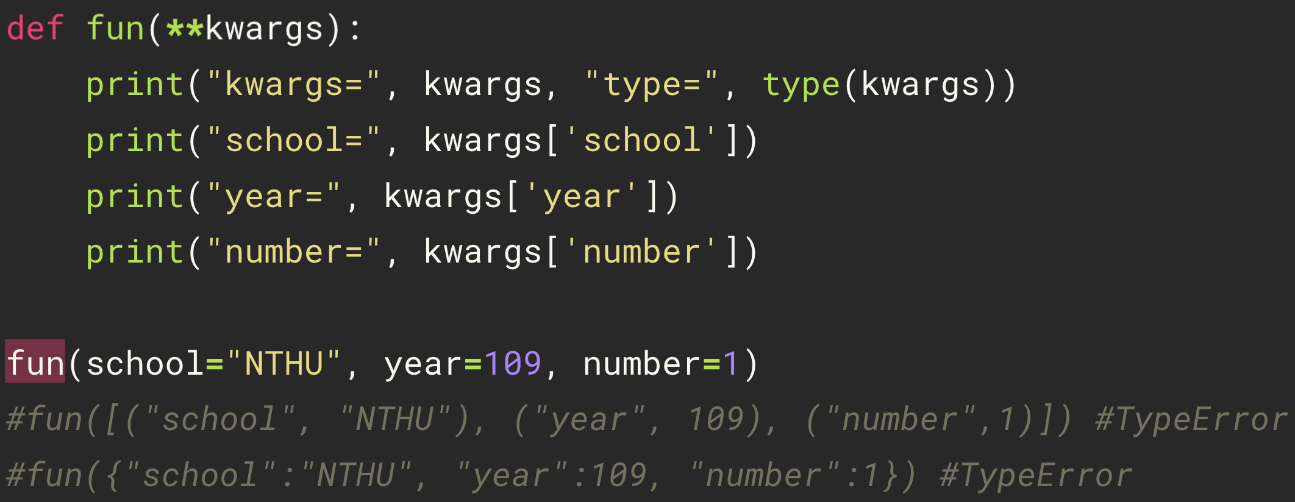
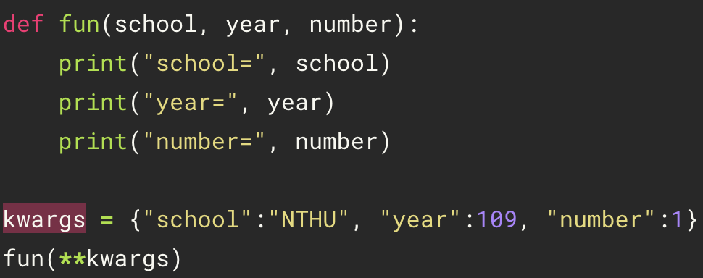
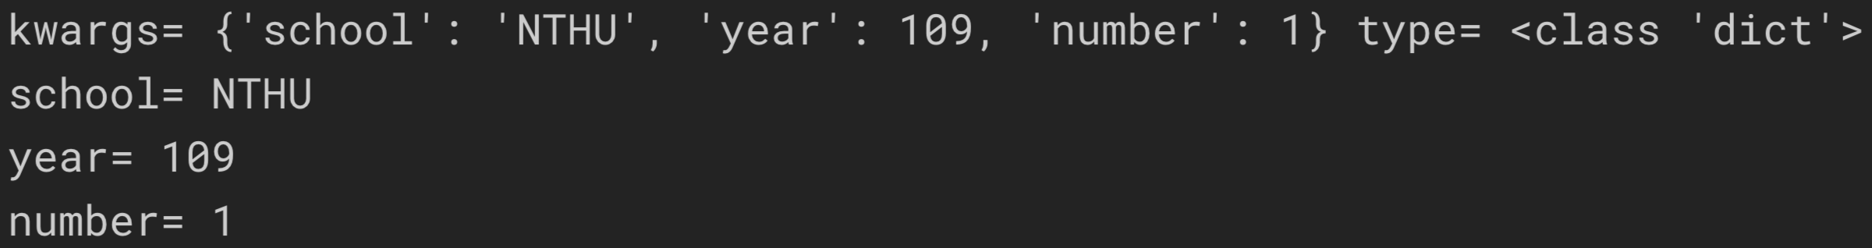
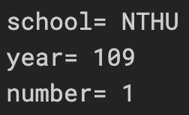
Packing or Unpacking Dict into kwargs
148
Packing kwargs
Unpacking kwargs
remain dict type!!!
Notes:
http://kodango.com/variable-arguments-in-python

Slide 27
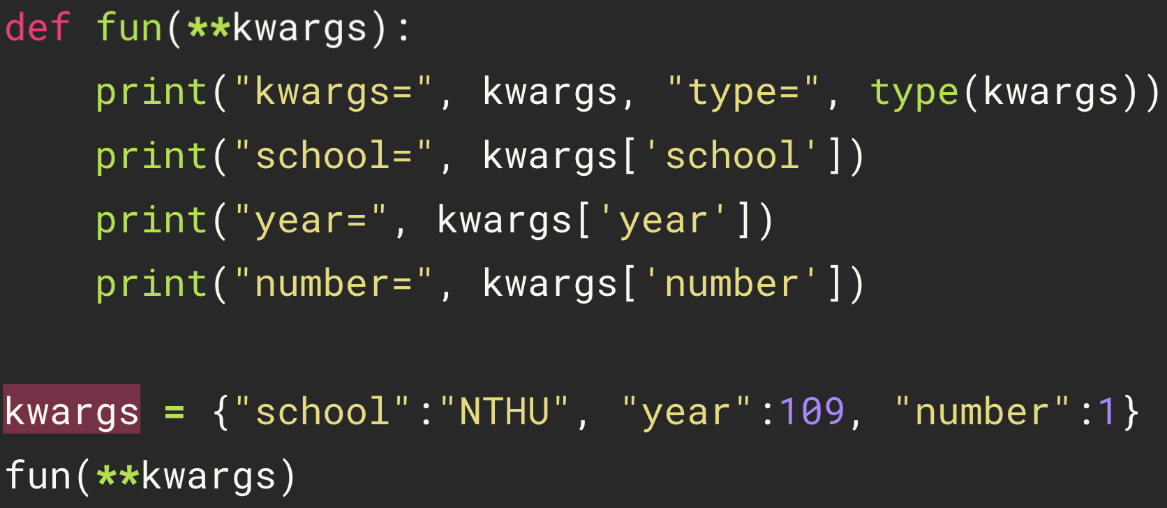
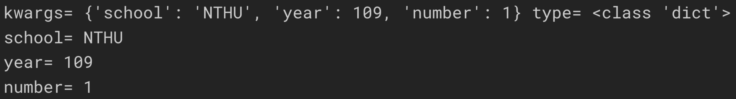
Packing and Unpacking Dict into kwargs
149
Notes:
http://kodango.com/variable-arguments-in-python

Slide 28
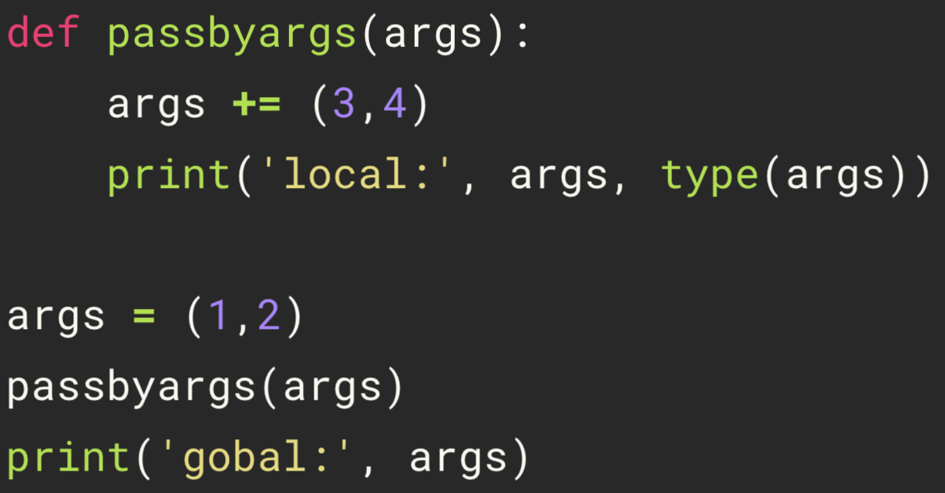
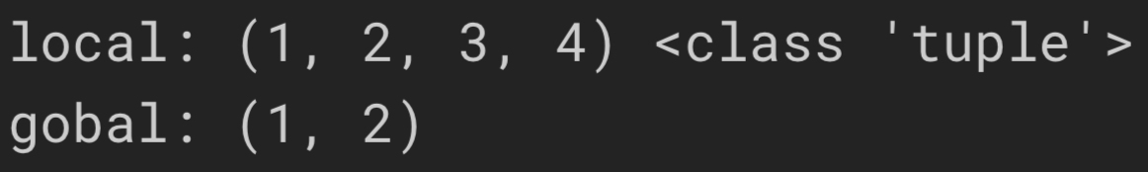
Pass by Tuple
150
Notes:
http://kodango.com/variable-arguments-in-python

Slide 29
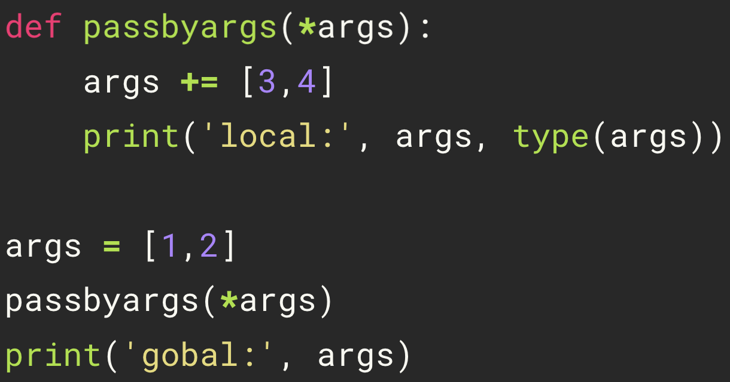
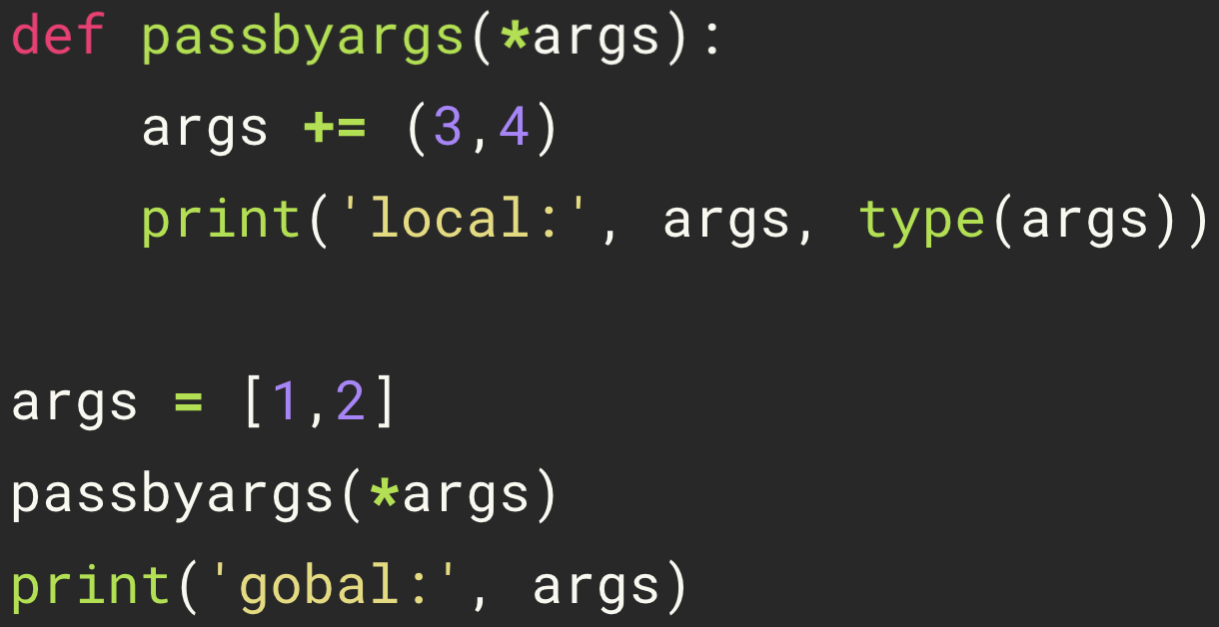
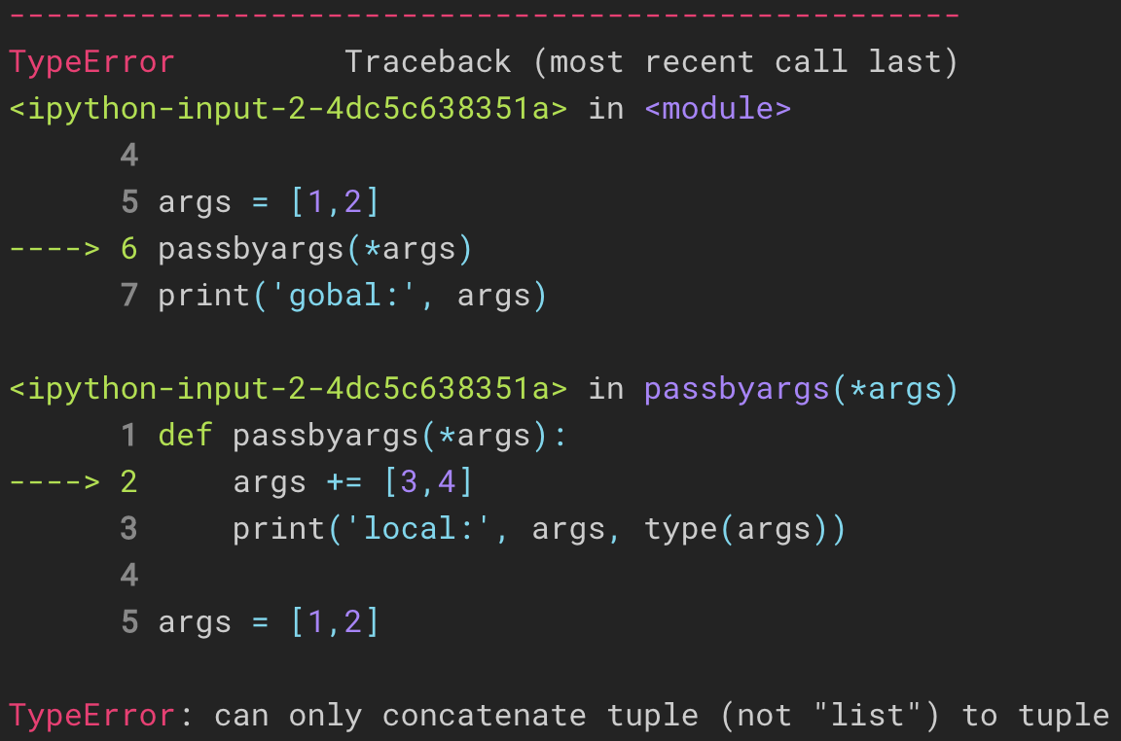
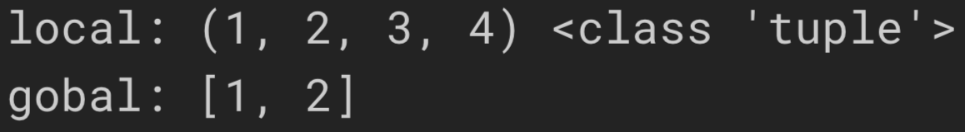
Pass by Unpacking Arguments
151
Notes:
http://kodango.com/variable-arguments-in-python

Slide 30
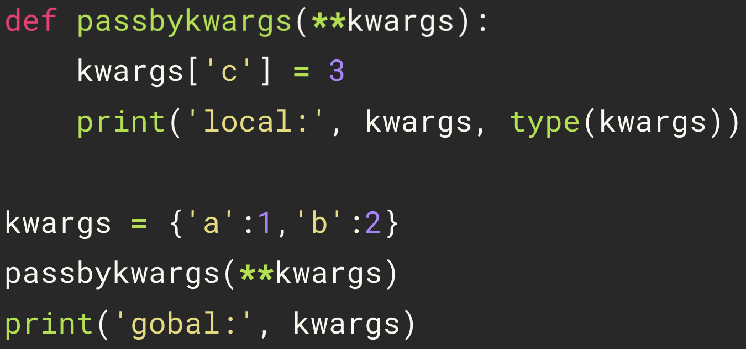
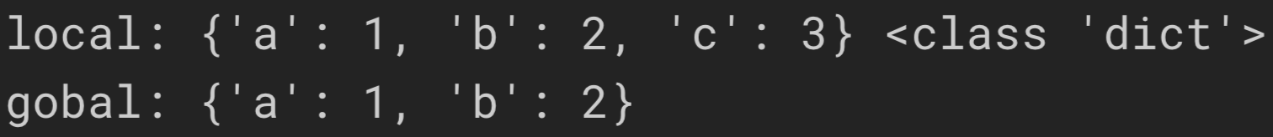
Pass by Unpacking Keyword Arguments
152
Notes:
http://kodango.com/variable-arguments-in-python

Slide 31
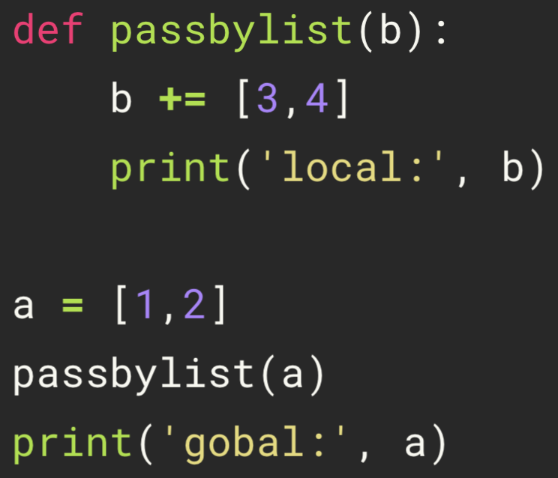
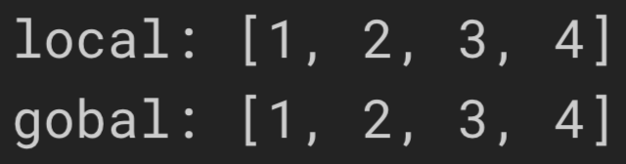
Pass by List
153
Notes:
http://kodango.com/variable-arguments-in-python

Slide 32
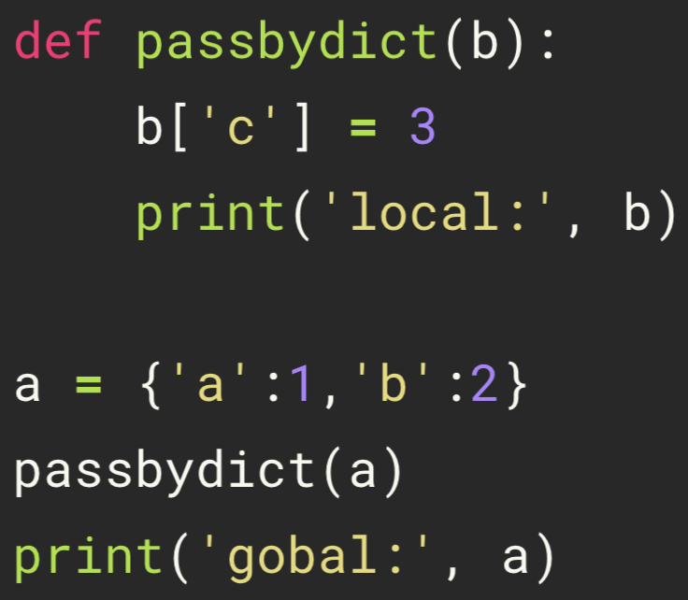
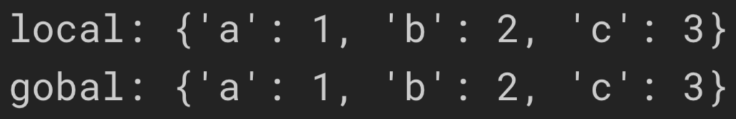
Pass by Dict
154
Notes:
http://kodango.com/variable-arguments-in-python

Slide 33
Practice
155
>>> def all_the_args(*args, **kwargs):
... print(args)
... print(kwargs)
>>> args = (1, 2, 3, 4)
>>> kwargs = {"a": 3, "b": 4}
>>> all_the_args(*args) # => (1, 2, 3, 4)
>>> all_the_args(**kwargs) # => (a=3, b=4)
>>> all_the_args(*args, **kwargs) # => (1, 2, 3, 4, a=3, b=4)
>>> def add(x, y):
... print("x is {} and y is {}".format(x, y))
... return x + y
>>> add(5, 6)
>>> add(y=6, x=5)
>>> def varargs(*args):
... return args
>>> varargs(1, 2, 3) # => (1, 2, 3)
>>> def swap(x, y):
... return y, x
>>> x = 1
>>> y = 2
>>> x, y = swap(x, y) # => x = 2, y = 1
>>> def create_adder(x):
... def adder(y):
... return x + y
... return adder
>>> add_10 = create_adder(10)
>>> add_10(3) # => 13
>>> def keyword_args(**kwargs):
... return kwargs
>>> keyword_args(big="foot", loch="ness")
Notes:
http://kodango.com/variable-arguments-in-python

Slide 34
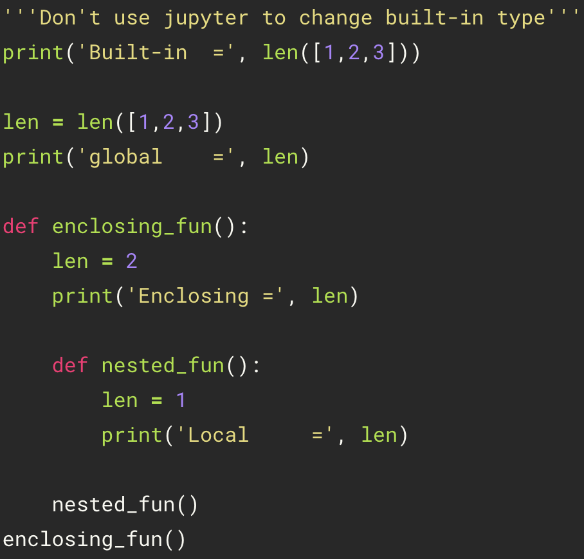
Python Scopes and Namespaces
156
Built-in
Global Scope
(or module)
Enclosing Scope
(or nonlocal)
Local Scope
(or function)
Notes:
https://docs.python.org/3.8/tutorial/classes.html#python-scopes-and-namespaces
https://note.qidong.name/2017/07/python-legb/

Slide 35
Local, Global, and Nonlocal Variables
157
Global variables: A variables declared outside of the function or
in the global scope
Local variables: Any variables declared inside the function or
in the local scope
Nonlocal variables: Used in nested functions whose local scope
is not defined
Notes:
https://www.programiz.com/python-programming/global-local-nonlocal-variables

Slide 36
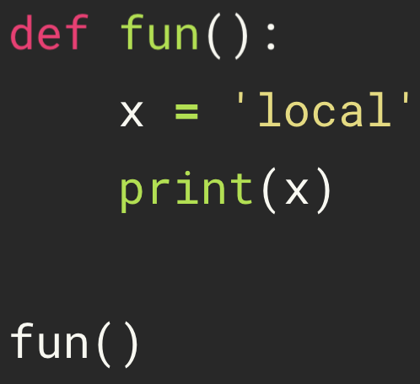
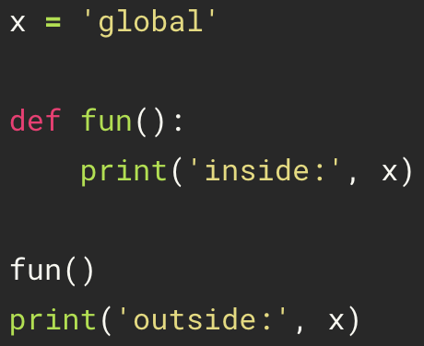
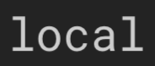
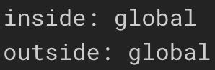
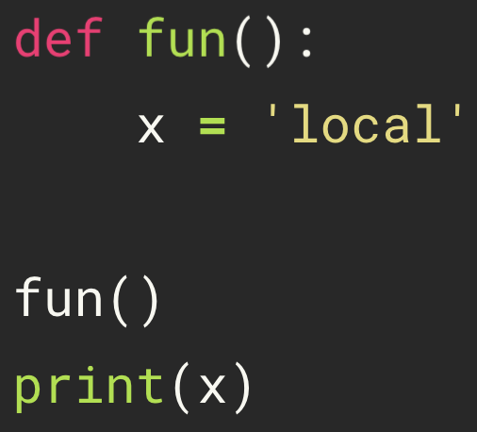
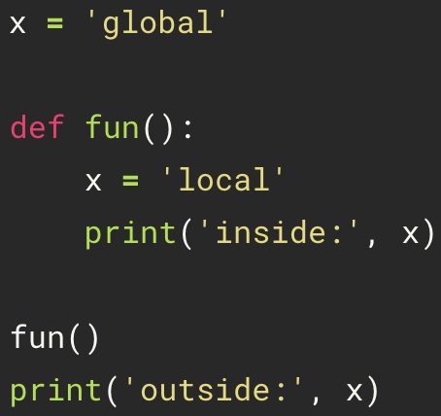
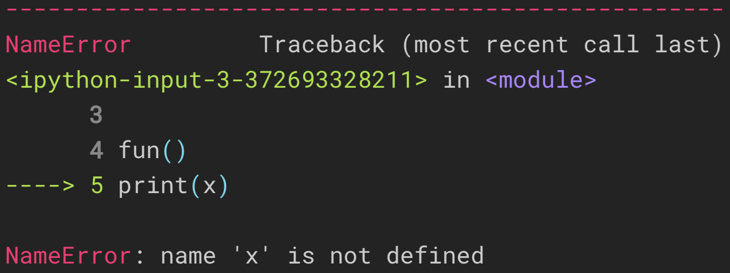
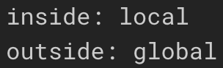
Local and Global Variables
158
Local
Global

Slide 37
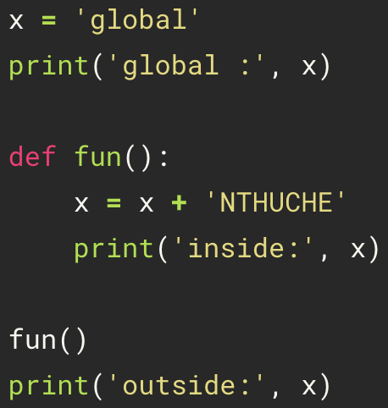
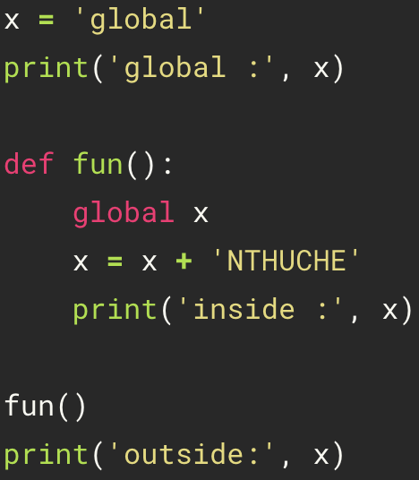
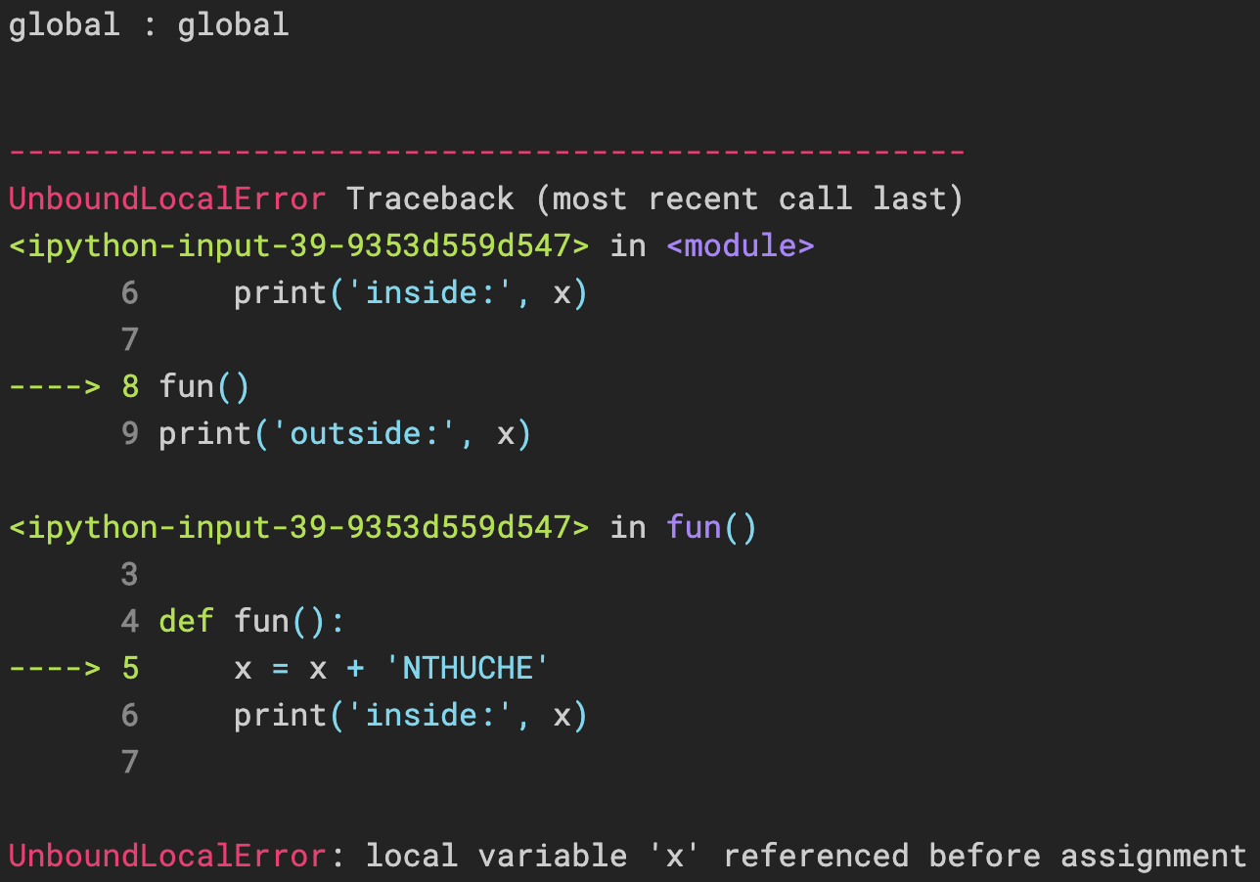

Global Variable
159

Slide 38


Nonlocal Variable
160
Notes:
https://www.programiz.com/python-programming/global-local-nonlocal-variables

Slide 39


Practice
161
Notes:
https://www.programiz.com/python-programming/global-local-nonlocal-variables

Slide 40




Practice
162
Notes:
https://docs.python.org/3.8/tutorial/classes.html#python-scopes-and-namespaces

Slide 41
Python Scopes and Namespaces
163
>>> x = 'global'
>>> def a():
>>> print(x)
>>> def b():
>>> print(x)
>>> b()
>>> a()
x = ?
Nonlocal -> Global
# => x = 'global'
x = ?
Local -> Nonlocal -> Global
# => x = 'global'
Notes:
https://docs.python.org/3.8/tutorial/classes.html#python-scopes-and-namespaces
https://note.qidong.name/2017/07/python-legb/
https://realpython.com/python-scope-legb-rule/

Slide 42




Python Scopes and Namespaces
164
Notes:
https://docs.python.org/3.8/tutorial/classes.html#python-scopes-and-namespaces
https://note.qidong.name/2017/07/python-legb/

Slide 43




Python Scopes and Namespaces
165
Notes:
https://docs.python.org/3.8/tutorial/classes.html#python-scopes-and-namespaces
https://note.qidong.name/2017/07/python-legb/

Slide 44
Python Closure
166
>>> def a(x):
>>> y = x
>>> def b():
>>> print(y)
>>> b()
>>> a("NTHU")
>>> def a(x):
>>> def b():
>>> print(x)
>>> b()
>>> a("NTHU")
Notes:
https://data-flair.training/blogs/python-closure/

Slide 45



Python Closure
167
Notes:
https://data-flair.training/blogs/python-closure/

Slide 46

Python Closure
168
“NTHU” is remembered even when the variable goes out of scope, or the function is removed from the namespace. If we delete outerfunc, myfunc still gives us “NTUCHE” .
Notes:
https://data-flair.training/blogs/python-closure/

Slide 47
Lambda Expressions
169
>>> def identity(x):
... return x
>>> lambda x: x

Slide 48




Lambda Expressions
170
lambda arguments : expression

Slide 49

Input and Output
171
Syntax
open("filename", mode)
execute “pwd” command, which can show the path of the input/output file
Mode | Meaning
r | Opens a file for reading only. The file pointer is placed at the beginning of the file. This is the default mode.
w | Opens a file for writing only. Overwrites the file if the file exists. If the file does not exist, creates a new file for writing.
a | Opens a file for appending. The file pointer is at the end of the file if the file exists. That is, the file is in the append mode. If the file does not exist, it creates a new file for writing.
Notes:
https://www.tutorialspoint.com/python/python_files_io.htm

Slide 50






write
172
open("filename", "w")
writing
appending
overwriting

Slide 51



read
173
file.txt
*****I Love ***David Shan-Hill Wong*** very much*****
NTHUCHE5566, NTHUCHE183.
open("filename", "r")
\n: A newline

Slide 52





read(number)
174
file.txt
*****I Love ***David Shan-Hill Wong*** very much*****
NTHUCHE5566, NTHUCHE183.

Slide 53





readline(number)
175
file.txt
*****I Love ***David Shan-Hill Wong*** very much*****
NTHUCHE5566, NTHUCHE183.

Slide 54


Loop over the File Object
176
*****I Love ***David Shan-Hill Wong*** very much*****
NTHUCHE5566, NTHUCHE183.
a[0]
file.txt
a[1]

Slide 55


lstrip(), rstrip(), strip()
177
file.txt
*****I Love ***David Shan-Hill Wong*** very much*****
NTHUCHE5566, NTHUCHE183.

Slide 56


replace()
178
file.txt
*****I Love ***David Shan-Hill Wong*** very much*****
NTHUCHE5566, NTHUCHE183.

Slide 57


split()
179
file.txt
*****I Love ***David Shan-Hill Wong*** very much*****
NTHUCHE5566, NTHUCHE183.

